Slide 1
Sneaker Classification Meeting 4
By: Shahan Rahman, Hasibul Islam, Jun Zheng & Carlos Vides
Notes:
Begin development and load data into python script.
Finalize on sneaker catalog and have all images needed.
Decided how big should our database should be
Everyone individual roles starts which will result in every person having a slide that represents there progress with their roles.
Compare result of Connor project with replacing our data

Slide 2
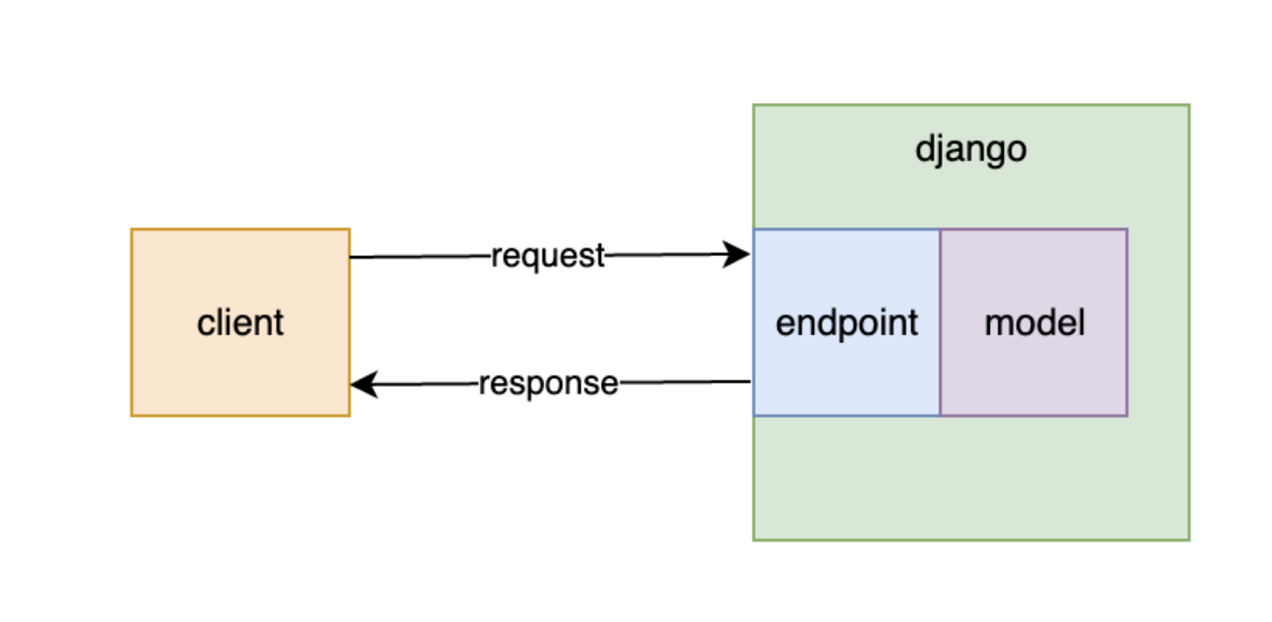
Work Explained
Backend Engineer & QA Tester - Carlos
Currently Learning Python3
Will use Django Backend Framework API
We’ll make a Django API that loads and runs a trained machine learning mode classifying sneakers

Slide 3
Adjusted Data
As advised in the previous meeting our group wanted to achieve the best results possible, therefore we used similar images that you come across with stock photos.
This means taking all the extreme photos out and comparing results.

Slide 4
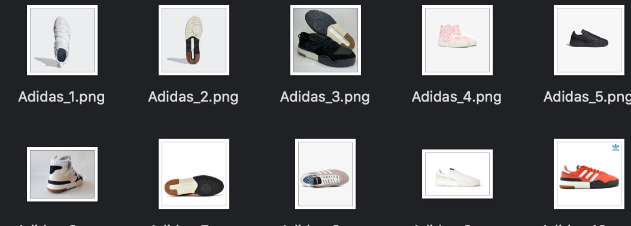
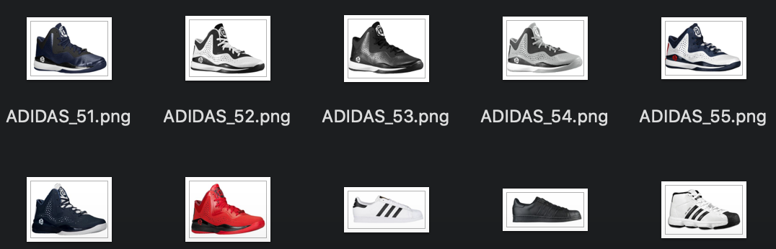
Our Modification
As one can see we took out the extreme photos and replaced the data set with more still and white photos of the sneakers
Also we achieved tried to achieve similar results as Connor

Slide 5
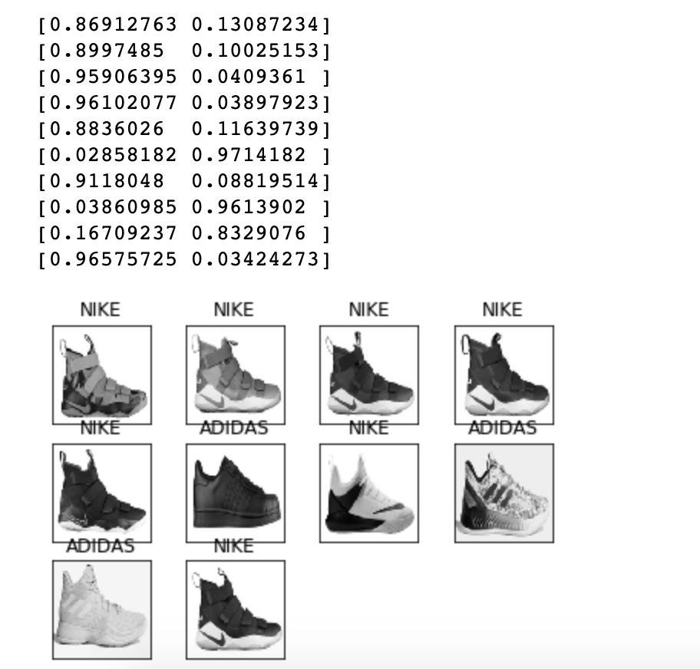
Our Results
After the script ran we can with an accuracy of 86% similar to Connor. Therefore, we now know our date set before was faulty with the extreme images. Now we tried two different algorithms that we wanted to try out.

Slide 6
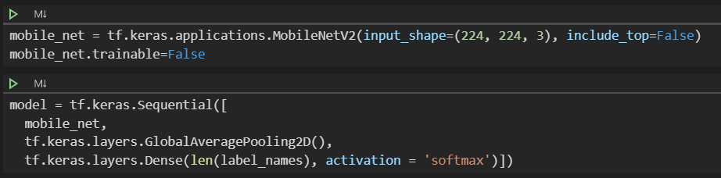
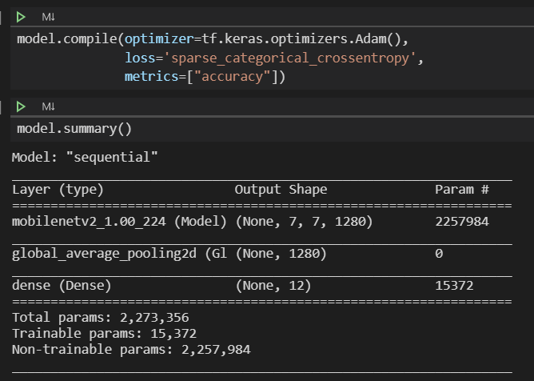
A new learning algorithm
The new learning algorithm is a transfer learning algorithm.
Use the existe model MobileNetV2 to training our data.
The model is downloading from tensorflow.keras.applications

Slide 7
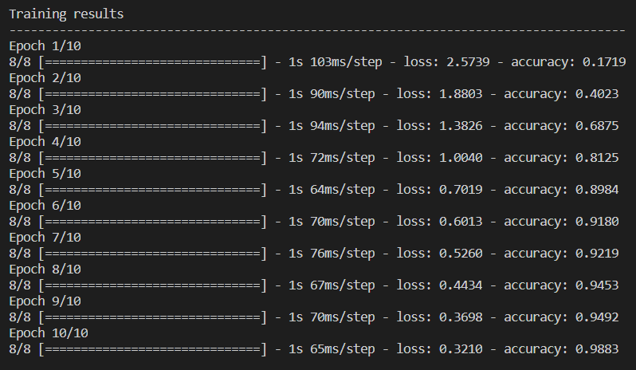
New Learning Algorithm Results
The accuracy is increase base on the number of epoch. after 10 epoch, the accuracy is closed to 0.99.

Slide 8
What we plan to do between today and next meeting?
Try input “extreme” Photos and adjust algorithm to get better results
Have a team to keep looking for better algorithms
Discuss target goal for accuracy

Slide 9
Thank YOU!

